Slide 1
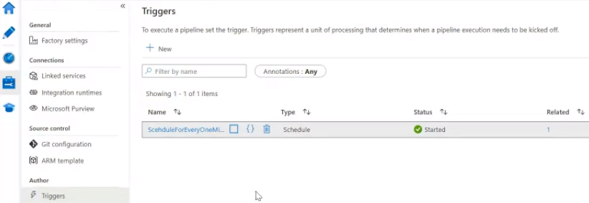
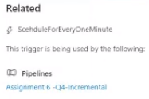

Slide 2
Many to Many
Schedule Trigger
Pipeline

Slide 3
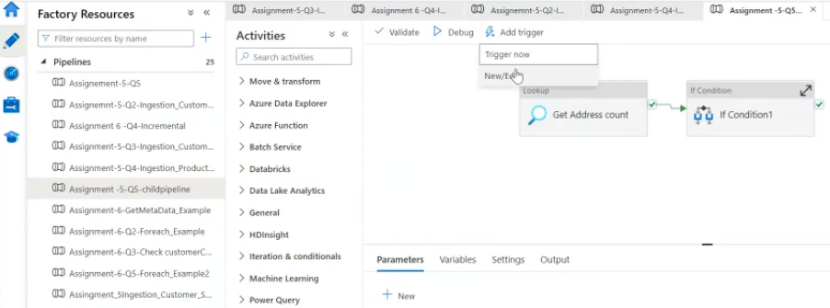
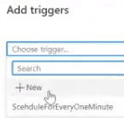

Slide 4
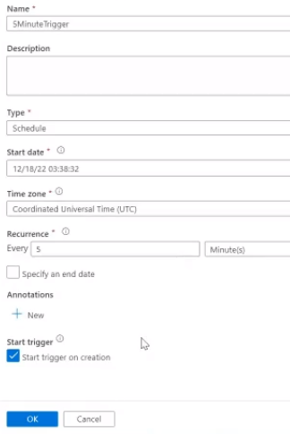
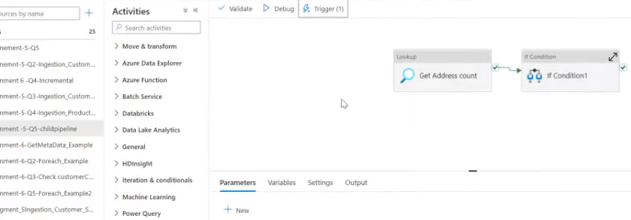

Slide 5
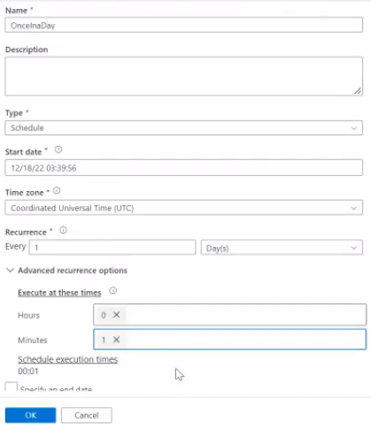
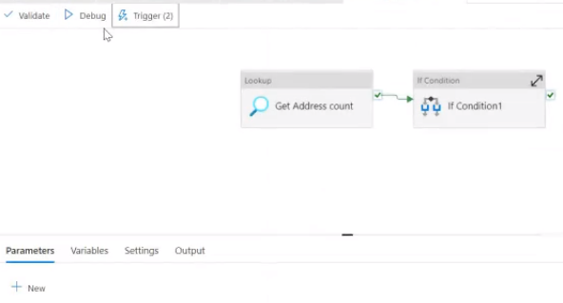
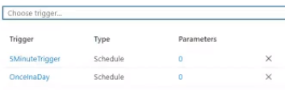

Slide 6
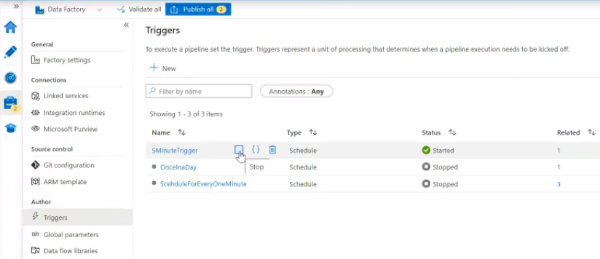
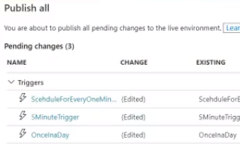
After testing triggers, immediately stop the pipeline.
If you forget to stop meanwhile it keep on running. If keep on running every minute , it will going to cost more.
In general real-time projects, 5 to 6 triggers handles around 200 pipelines.

Slide 7
Main Pipeline --> Execute Pipeline → Child Pipeline
- No need to add trigger directly to the child pipeline. If your parent pipeline have trigger, parent pipeline trigger frequency will decide the
child pipeline frequency.

